Slide 1

Differential Equations
Amara Fida
Madina Khokhar
Aneeba Shezadi
Esha Mansoor

Slide 2
Laplace Transform :
Why called Laplace Transform ?
Why Study Laplace Transform ?
Defination Laplace Transform ?

Slide 3
Why called Laplace transform
Laplace : Mathematician Name
Transform: one variable change into another variable (s variable change into t and t change into s)
Why Study Laplace Transform
Solve initial value problem
Solve Linear Differential Equation (solve in minimum steps)
Defination:
The Laplace Transform is a linear operator that switched a function f(t) to f(s).

Slide 4
Laplace Transform
S
T
f(s)= ∫e ^-st f(t)dt
integral 0 to infinity
 But this equation not converge for every function
EXAMPLE
F(t)=1
f(s)= e^-st .f(t)dt
f(s)=e^-st.(1)dt F(s)=| e^-st/-s|

Slide 5
Laplace Transform
-1/s [0-1]
1/s Answer
LT formulas :
Basic formulas of LT :
L(e^at) =
L(cos at) =
1/s-a
s/s^2 + a^2
= s/s^2 +-a^2
= under root n+1/s^n+1
L(cosht)
L(t^n)

Slide 6
Properties of Laplace Transform :
W E D I S C U S S T W O P R OP E R T I E S OF
L A P L A C E T R A N S F O R M
) L I N E A R P R O P E R T Y
) F I R S T S H I F T I N G P R O P E R T Y

Slide 7
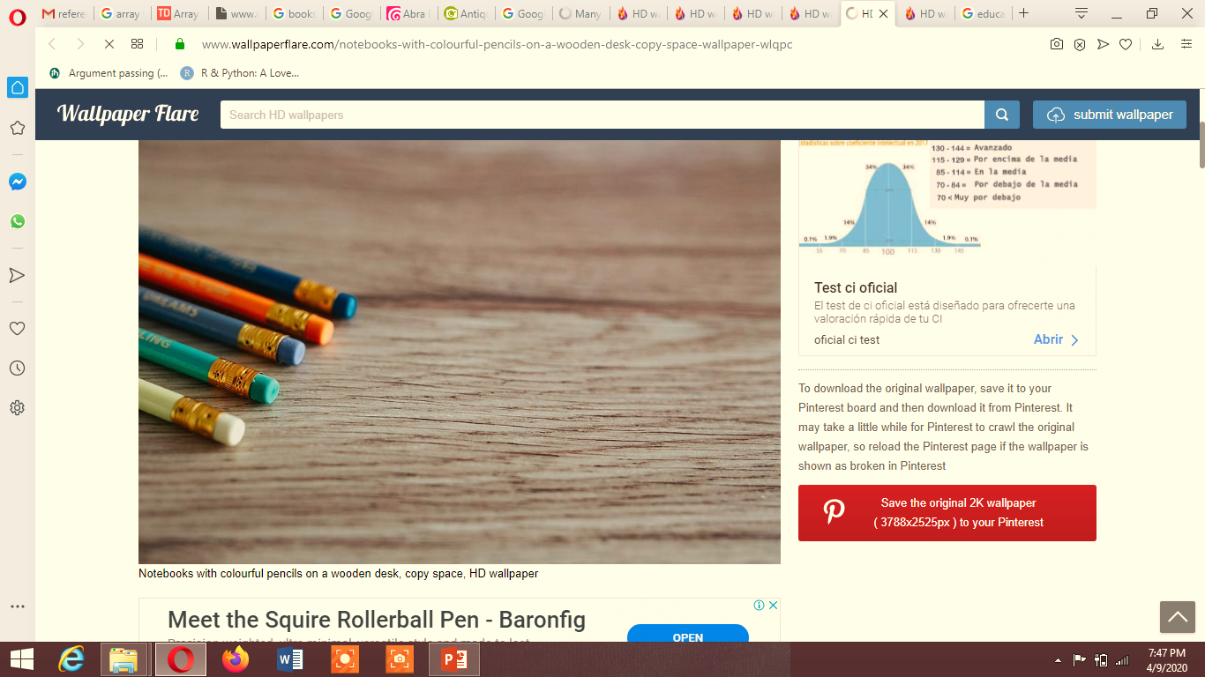
Inverse Laplace

Slide 8
Definition
The inverse Laplace transform definition comes as the inverse operation of the Laplace transformation and is mathematically is writen as:
f=L−1(F).

Slide 9
Laplace and inverse laplace
L{f(t)} f(s) (Laplace Transform)
F(t) L^-1 {f(s)} (Inverse Transform)

Slide 10

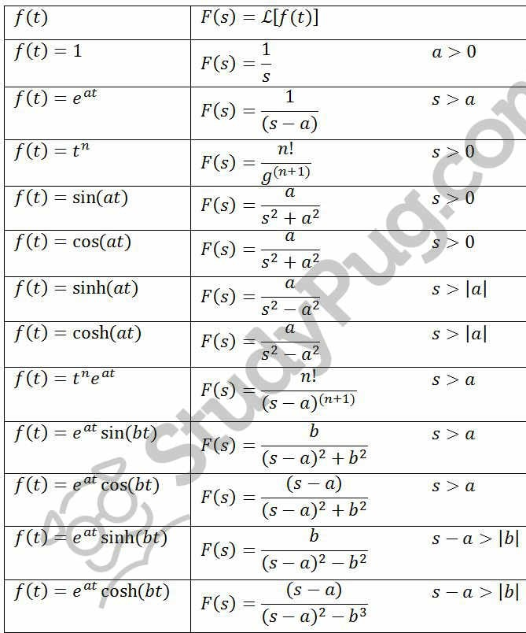
Table of formulas

Slide 11
The Laplace transform and technology
Most computer algebra systems have built-in Laplace transform and inverse transform capabilities. In particular, some systems (for example, Maple) have sophisticated differential equation solvers with a “laplace” option for IVPs.

Slide 12
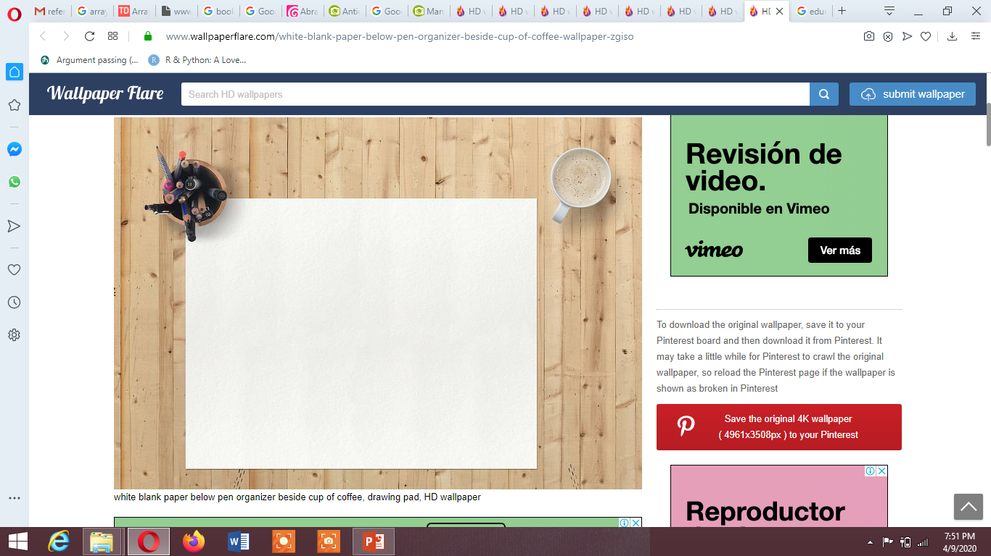
Differential Equation

Slide 13
Differential Equation
E X A M P L E :
DY / DT + 1 0 Y = E ^ X
T H E R E A R E T W O T Y P E S O F D I F F E R E N T I A L
E Q U A T I O N :
) O D E
) P D E

Slide 14

Ordinary Differential Equation

Slide 15
Ordinary Differential Equation
E Q U A T I O N C O N T A I N :
I N D E P E N D E N T V A R I A B L E ( S I N G L E )
D E P E N D E N T V A R I A B L E ( O N E O R M O R E )

Slide 16
Partial Differential Equation
Equation contain:
Dependent variable (one ) Independent variable (one or m0re)

